Slide 1





Space Weathering of Dark Regolith and Carbonaceous Asteroids
Emily Clark
Mentor: Dr. Mark Loeffler
School: Northern Arizona University
Arizona NASA Space Grant Statewide Student Research Symposium
Arizona State University
April 19, 2024

Slide 2
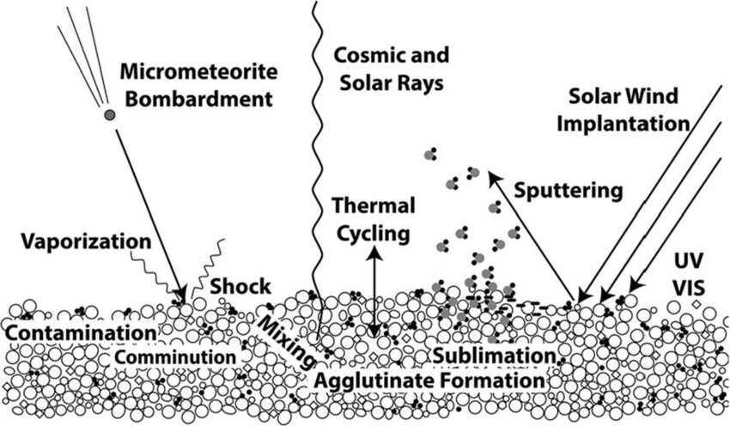
Background
Bodies without atmospheres are weathered by
  Micrometeorite Bombardment
  Cosmic Rays
  Solar Wind
Magnetite is an important component in carbonaceous asteroid surfaces
  Bennu, NASA’s OSIRIS-REx
Lab experiments help us understand spectra of these materials for comparison to remote sensing observations
Pieters & Noble 2016

Slide 3
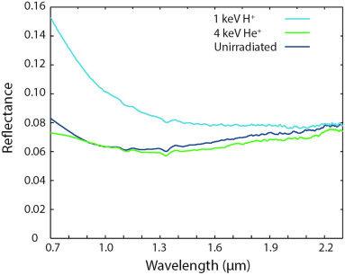
Introduction
Chaves et al. 2023 irradiated magnetite with protons
  Spectral bluing 0.7-1.0 µm
  Increase in brightness
Observed that the surface was chemically reduced to iron
  Iron usually causes reddening of spectral slopes
We wanted to investigate the effects of space weathering on magnetite in more detail
  Magnetite and CI simulant
Chaves 2023

Slide 4
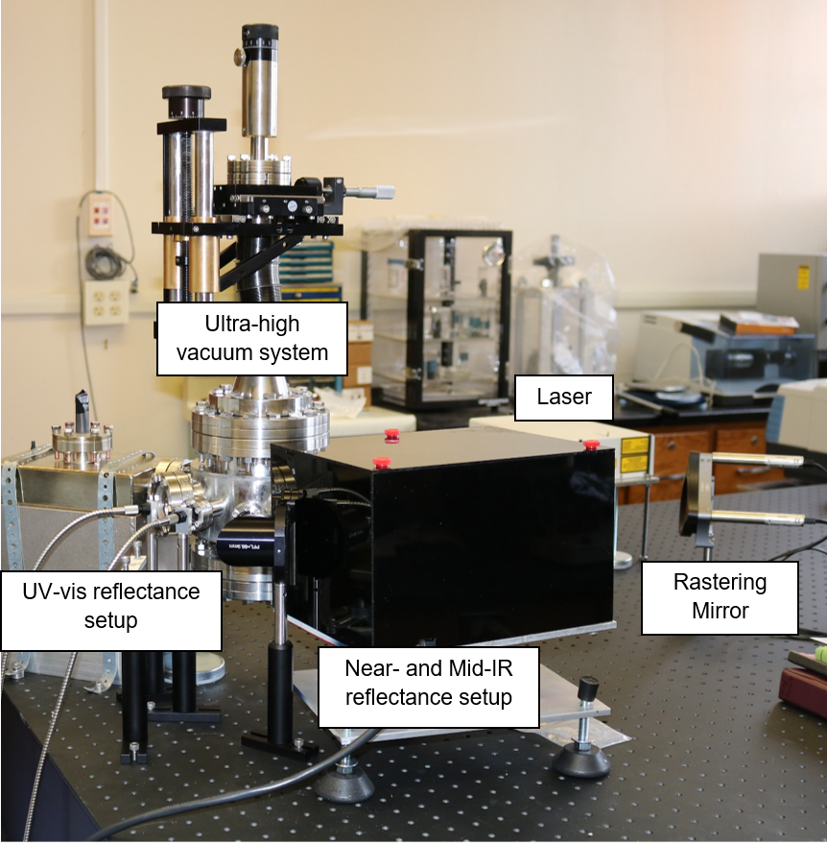
Methods
Prepared pressed pellets of magnetite and CI simulant
  < 45 µm grain size
  11000 lbs of force
  ~5 min
Characterized initial reflectance spectra
  Ultraviolet-visible (UV-Vis) (0.25-0.9 µm)
  Near infrared (NIR) (0.75-2.5 µm)
Ultra-high vacuum system
  ~10⁻⁸ Torr
Loeffler 2018

Slide 5
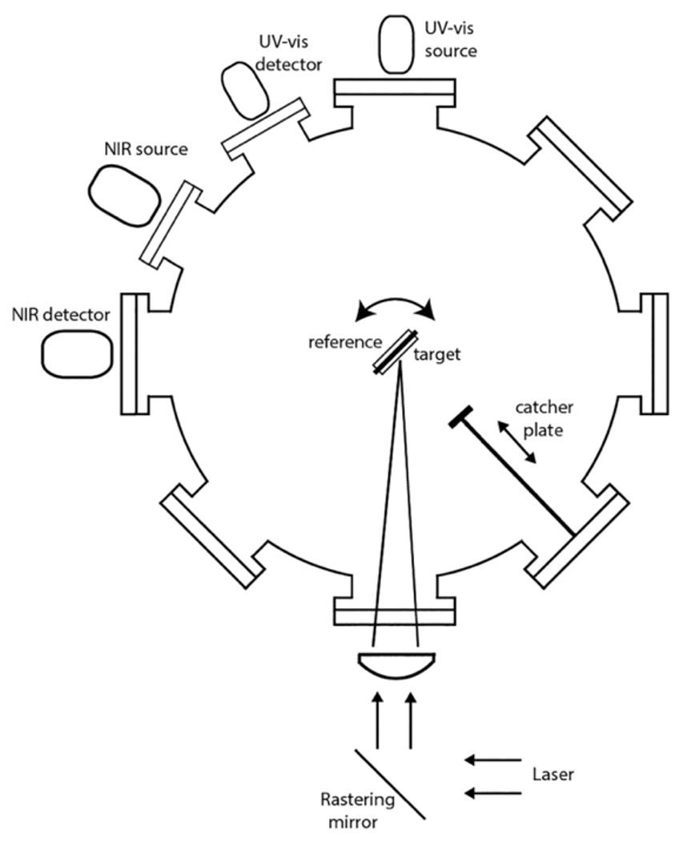
Methods
Ablated iron with a pulsed laser
  ~40 mJ per pulse
  Ablated material gets deposited onto sample
Removed samples at pre-specified intervals of iron deposit thickness to perform reflectance spectroscopy
  Fresh, 5 nm, 10 nm, 15 nm, 20 nm, 30 nm, 45 nm, 60 nm, 80 nm, 100 nm, 150 nm
Loeffler

Slide 6
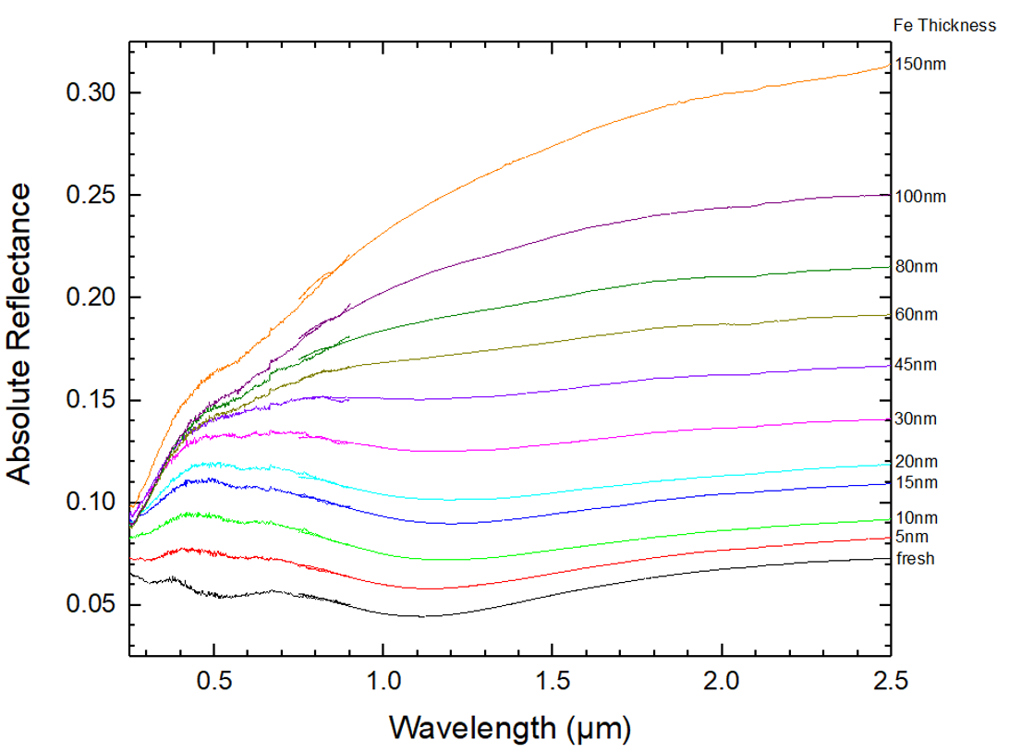
Results - Magnetite
UV-Vis and NIR reflectance spectra as a function of Fe deposit thickness
  Reflectance increases with more Fe at all wavelengths
    Fe is a reflective material
  We do observe a slight bluing in the 0.7-1.0 µm range
    Not as drastic as Chaves et al. 2023
Clark

Slide 7
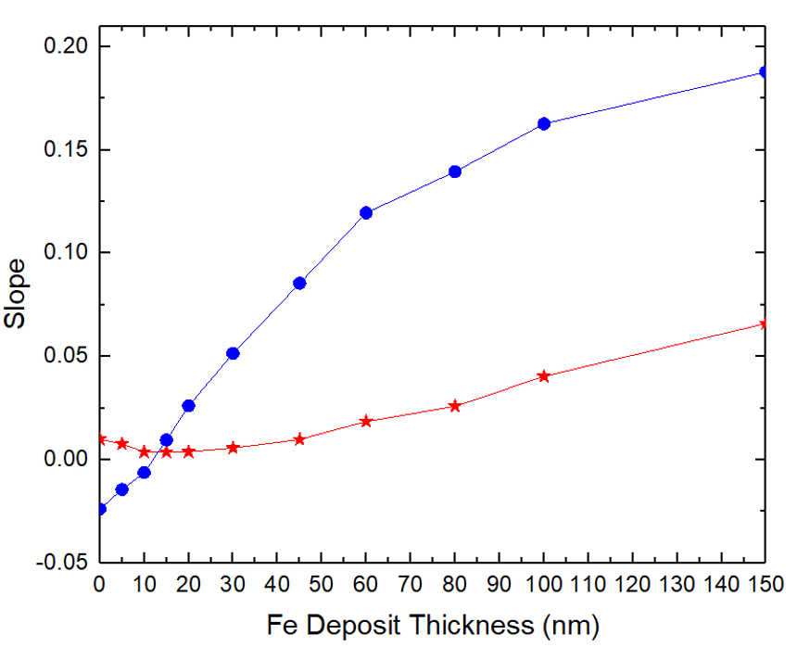
Results - Magnetite
Average slopes across UV-Vis and NIR wavelengths
  Blue line is UV-Vis and red line is NIR
    UV: starts out blue and becomes more red with more iron
    IR: mostly reddens
Clark

Slide 8
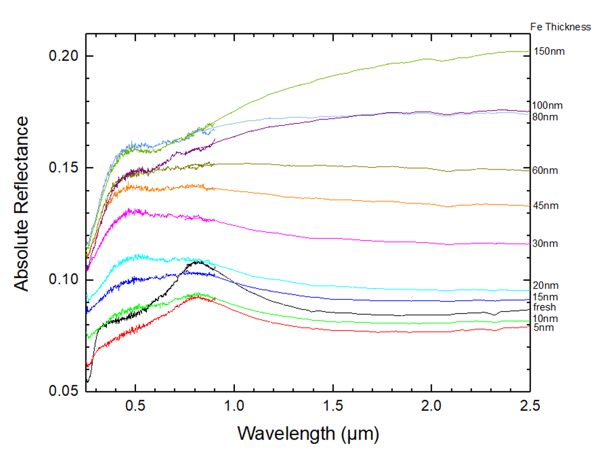
Results - CI Simulant
UV-Vis and NIR reflectance spectra as a function of Fe deposit thickness
  Reflectance initially decreases and subsequently increases
  Attenuation of absorption band
    Begins to mimic Fe
  Similar trends as magnetite
    Suggests these materials have similar space weathering trends
Clark

Slide 9
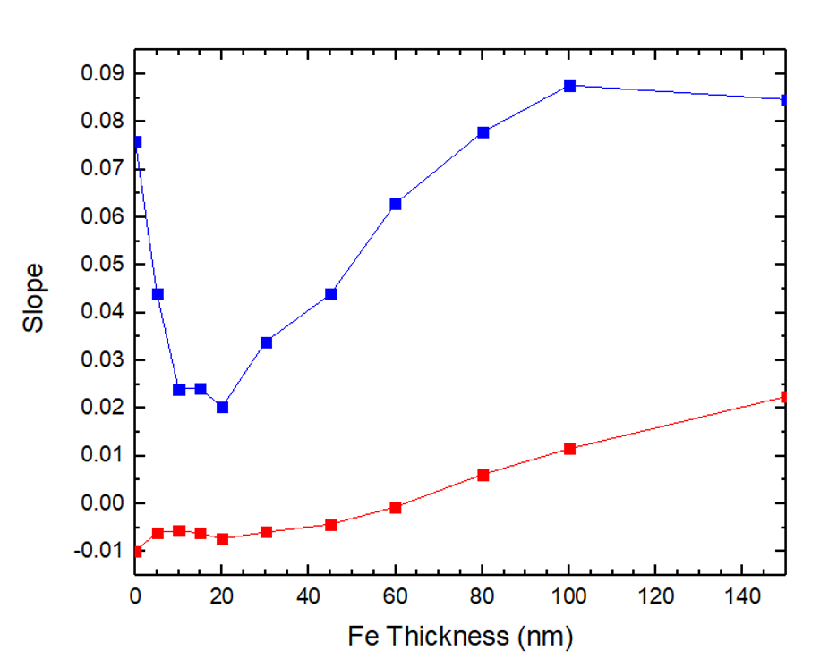
Results - CI Simulant
Average slopes across UV-Vis and NIR wavelengths
  Blue line is UV-Vis and red line is NIR
    UV: steep bluing at the beginning due to attenuation of absorption around 0.8 µm band and subsequent reddening
    IR: steadily reddens
Clark

Slide 10
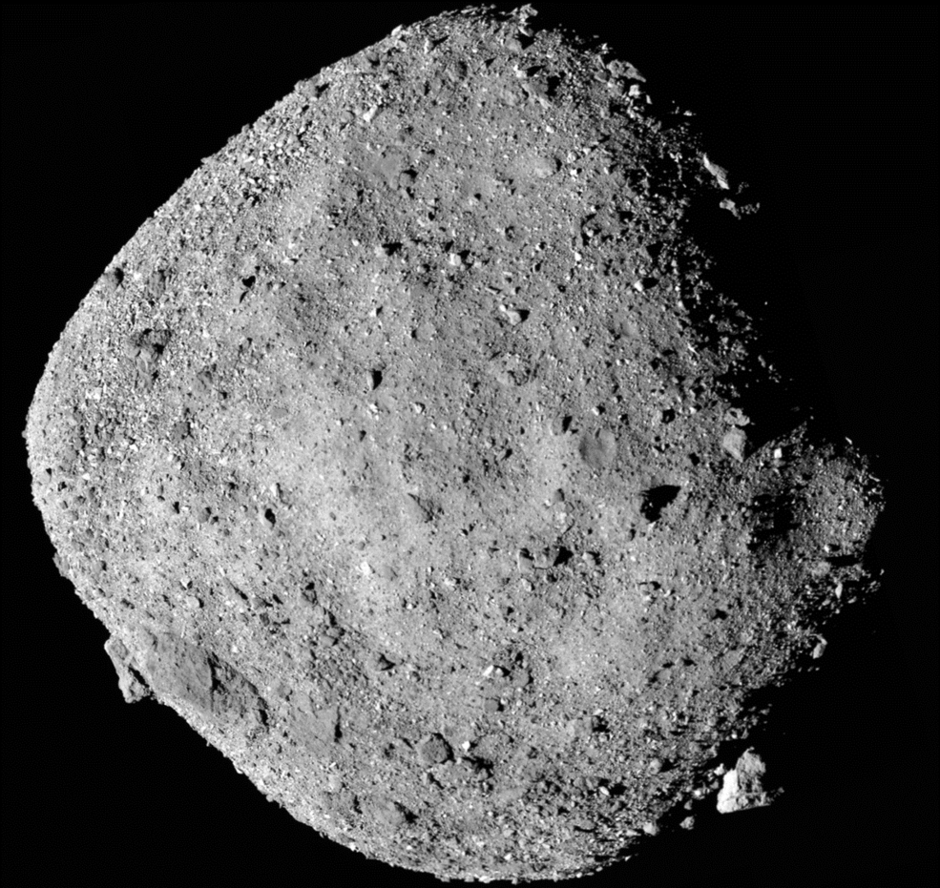
Conclusions
Depositing metallic Fe on dark materials generally causes an increase in reflectance
Spectral slope generally reddens with more Fe
  Consistent with brighter silicates
While we observe slight spectral bluing in magnetite from 0.7-1.0 µm it is less than shown for H⁺ irradiation of magnetite
NASA 2020

Slide 11
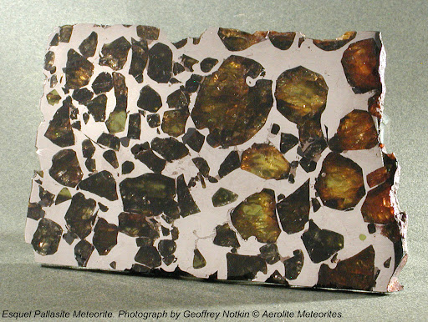
Future Work
Repeat procedure with bright material
  Olivine
  Also important component of asteroids
Ultimately, compare to remote sensing observations
Important for analysis of samples from OSIRIS REx
Goldstein 2010

Slide 12
Thank You
Acknowledgements: Special thank you to Dr. Mark Loeffler and AZ Space Grant!

